Slide 1
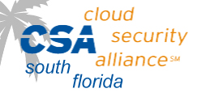
Cloud Security Alliance – Anatomy of a Cyber Attack
March 28th, 2013

Slide 3
Mercantil Commercebank, Empowering your World
InfraGard Meeting
March 2013
Notes:
Good morning.
I appreciate the opportunity to talk to you this morning about the Institutional Marketing Department. We have dynamic team that works very, very hard. They produce great work.
Today’s presentation will focus on the roles and responsibilities of the department and how we create value to the organization.

Slide 4
Mercantil Commercebank
Financial Strength to Empower Your Growth

Slide 5
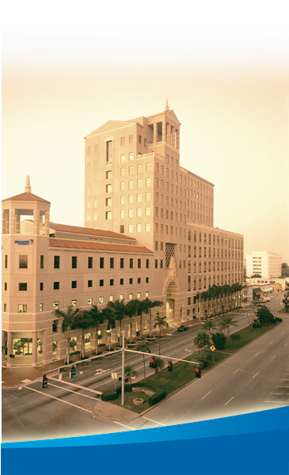
Mercantil Commercebank
Nationally chartered global banking organization headquartered in Coral Gables, Florida with banking centers located across South Florida, Houston and New York.
Mercantil Commercebank is ranked in the top five largest banks domiciled in Florida with $6.8 billion in assets.¹
In September 2012, The American Banker ranked Mercantil Commercebank’s holding company among the top 150 banking institutions in the U.S.
The Bank’s subsidiaries, Mercantil Commercebank Investment Services and Mercantil Commercebank Trust Company, offer professional wealth management, brokerage, investment advisory, portfolio management, trust and estate planning expertise to individuals and companies since 2002.
Founded in 1979, Mercantil Commercebank is beneficially owned by Mercantil Servicios Financieros (MSF) in Venezuela through U.S. bank holding companies.
¹ December 31, 2012

Slide 6
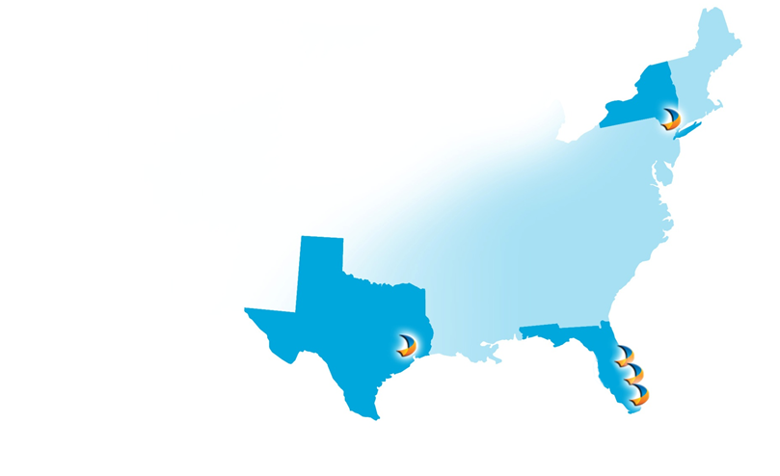
Positioned to Meet Our Customers Needs
Longevity in our markets provides consistency for customers
Decisions are made by local professionals who know the community
Commercial bankers have extensive banking experience in the U.S. and around the globe
Uniquely qualified operations support team is committed to service excellence
In addition to serving the needs of the local markets, strategic locations in New York and Houston also serve the specialized needs of needs of companies in the Oil & Gas industry
New York City
18 Banking Centers
15 – South Florida
2 – Houston
1 – New York
Over 700 employees
More than 100,000 customers
Palm Beach
Houston
Fort Lauderdale
Miami

Slide 7
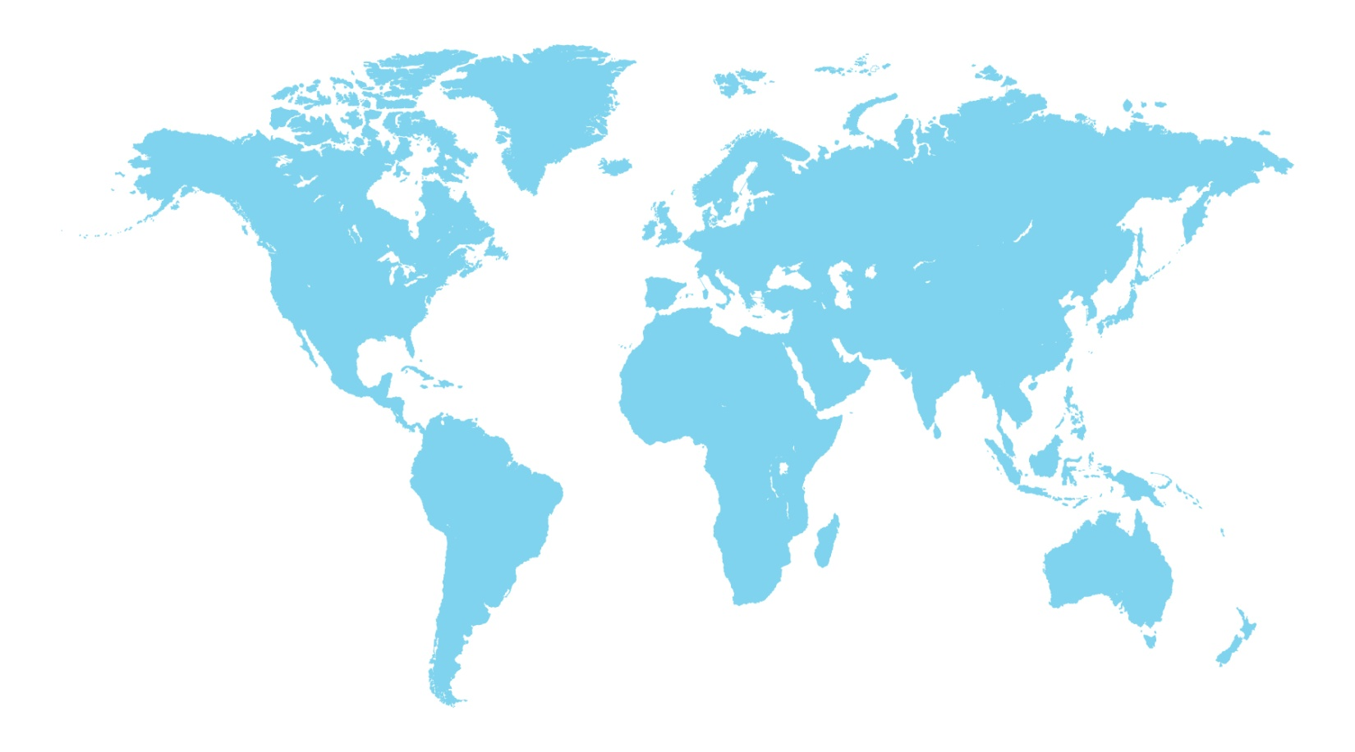
About our Parent Company Mercantil Servicios Financieros (Mercantil)
Leading global financial institution in Venezuela with over US$33 billion¹ in assets and 87 years of experience
Serves more than 4 million customers
Presence in 11 countries in the Americas, Europe and Asia
Mercantil stock is listed on the Caracas Stock Exchange (MVZ.A and MVZ.B) and trades “over the counter” (OTC) in the United States (MSFZY and MSFJY) through an ADR program level 1.
New York
Zurich
Houston
Mexico
Coral Gables
Cayman Islands
Hong Kong
Panama
Curacao
Venezuela
Bogota
Lima
Sao Paulo
¹ December 31, 2012; presented in accordance with the standards of the Venezuelan National Securities Superintendency (SNV) and converted at the average exchange rate of Bs. 4.2893/1US$. There is an Exchange control in place in Venezuela since February 2003. On February 8, 2013, Venezuela announced the devaluation of the controlled exchange rate from Bs. 4.2893/US$ to 6.2842/US$.
Notes:
7

Slide 8
Products & Services
Personal
Commercial
Deposit Accounts
Checking & Savings
Money Market
Certificates of Deposit
Retirement Accounts
Lending
Personal Loans
Residential Loans & Home Equity
Auto & Boat Loans
Services
Online Banking & Bill Pay
Online Wire Transfers
Visa® Debit Cards & Rewards
Lending
Lines of Credit
Term Loans
Commercial Real Estate Mortgages
Account Receivable Financing
Participations & Syndications
SBA & Ex-Im Bank Loans
Cash Management
Business Online Banking
Depository Accounts
Remote Deposit
Lockbox
Visa® Business Debit Cards & Rewards
Trade Finance Services
Trade Services Online
Mercantil Trade Asia Ltd. (Hong Kong)

Slide 9
Security Overview

Slide 10
Attack Sophistication vs. Intruder Technical Knowledge
High
Coordinated DoD
Tools
Cross site scripting
“stealth” / advanced scanning techniques
Mobile
Malware
Intruder
Knowledge
Botnets
packet spoofing
denial of service
Staged
sniffers
distributed
attack tools
sweepers
SQL Injections
www attacks
back doors
Automated
probes/scans
disabling audits
GUI
hijacking
sessions
burglaries
exploiting known vulnerabilities
Attack
Sophistication
password cracking
self-replicating code
Intruders
Low
password guessing
1980
1990
2000
2012

Slide 11
Security Gaps
Attacks are more successful due to:
Weak layer perimeter security
The use of different attack vectors to exploit vulnerabilities
Lack of patch management
Lack of monitoring and periodic analysis (events, alerts, etc.)
Lack of awareness
Relaxed programming/developing practices
Rate of New/Emerging Technologies
Adaptive Attacks
Attackers change strategy and adapt to the protection mechanism

Slide 12
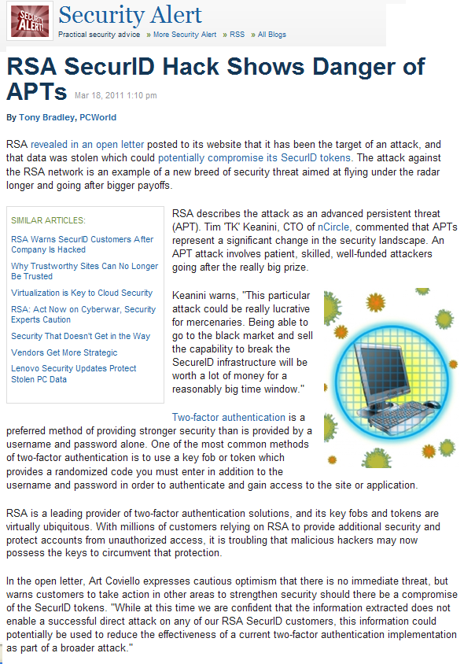
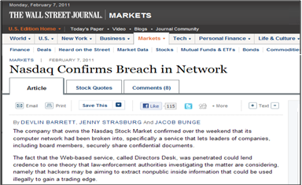
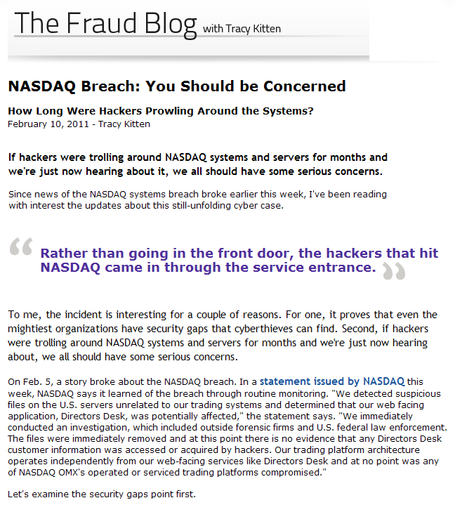
Are we paying attention?
“It's not denial. I'm just selective about the reality I accept.”
Calvin and Hobbes

Slide 13
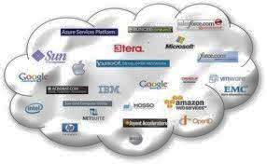
Multi-Layered Protection
Weak
Security
Policies
Lack of
Awareness
Desktop
Based
Infections
Web Based
Infections
Email Based
Infections
Internal
Threats
Network
Access
External
Threats
Unencrypted
Traffic
Lack of
Monitoring
Implement and enforce Information Security Policies
Educate Users and Conduct Periodic Monitoring
Antivirus, Anti-Malware, Desktop Firewall, and Device Control
Implement Strong Gateway Protection From Malware – Reputation Base -
Implement Secure Email Gateway
Email Protection
Implement Strong Access Controls and Network Segmentation
Network Access Controls - NAC
Implementation of Network Centric Defense
IDS/IPS, FW, WAF, etc
Encrypt Comm. Channels
Continuous Monitoring
Managed Security Services

Slide 14
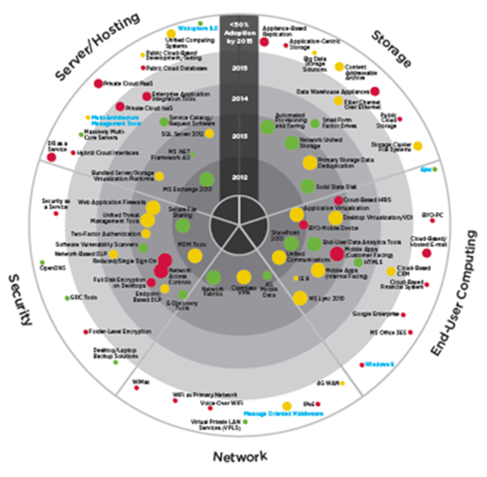
IS Challenges
Technologies by Mainstream Adoption Timeline, Value and Risk
Source: Executiveboard

Slide 15
Risk Management Matrix
Cloud Use |  | Data | Risk | Impact | Affected Assets | Overall Rating
SaaS | Collaboration | Customer personal sensitive data | H - M - L | H - M - L | Company reputation Customer trust | H - M - L
 | Enterprise Applications |  | H - M - L | H - M - L |  | H - M - L
 | Business Applications |  | H - M - L | H - M - L |  | H - M - L
PaaS | Web 2.0 Applications |  | H - M - L | H - M - L |  | H - M - L
 | Databases |  | H - M - L | H - M - L | HR data | H - M - L
 | Middleware |  | H - M - L | H - M - L |  | H - M - L
IaaS | Storage, Servers, Networks |  | H - M - L | H - M - L | Online Banking | H - M - L
 | Production custom applications |  | H - M - L | H - M - L |  | H - M - L
 | on-demand services |  | H - M - L | H - M - L |  | H - M - L

Slide 16
Security Considerations in the Cloud
Final Notes
Evaluating the feasibility of outsourcing to a cloud-computing service provider is an important part of the due diligence vendor risk management process. It is important to look beyond benefits, and make sure risk assessments are performed on the elements specific to that service.
Depending on the type of service and the needs, minimum considerations for ensuring data in the cloud is secure. The following are best industry practices when considering using the Cloud:
Data classification:
How sensitive is the data that will be placed in the cloud (e.g., confidential, critical, public) and what controls should be in place to ensure it is properly protected?
Data segregation:
What controls does the service provider have to ensure the integrity and confidentiality of the your company’s data?
Recoverability and Business Continuity Planning:
How will the service provider respond to disasters and ensure continued service?
Vendor Risk management:
Important part of the risk mitigation is to evaluate contracts and service level agreements are specific as to the ownership, location(s) and format(s) of data, and dispute resolution. Additionally, review of the data decommissioning practices.
Audit:
Auditors must conduct periodic audits to assess whether the controls are functioning appropriately.
Information Security:
Organizations may need to revise their information security policies, standards, and practices to incorporate the activities related to a cloud computing service provider.
Legal, Regulatory, and Reputational Considerations:
Important considerations for financial institutions before deploying a public cloud computing model include clearly identifying and mitigating legal, regulatory, and reputational risks.

Slide 17
References
FFIEC Guidance Cloud Computing
NIST - Guide for Security-Focused Configuration Management of Information Systems - Special Publication 800-128
NIST - Guidelines on Security and Privacy in Public Cloud Computing - - Special Publication 800-144
The NIST Definition of Cloud Computing - Special Publication 800-145
NIST - Cloud Computing Synopsis and Recommendations - Special Publication 800-146
European Network and Information Security Agency (ENISA) – Cloud Computing Security Risk Assessment.pdf
Legal Cloud Computing Association – http:// http://www.legalcloudcomputingassociation.org/

Slide 18
Thank You
18

Slide 19
Security
Priva(eers^{tm}
Anatomy of a Cyber Attack
Copyright© 2013 Security Privateers LLC. All Rights Reserved

Slide 20
AGENDA
AGENDA
Sub headline
Anatomy of a Cyber Attack
Michael Scheidell, CISO
Security Privateers
Timeline of Attack
Who, What, When, Where, How, Why
Panel and Questions
Who is responsible for Cloud Security?
Security Privateers Services
Working Together for Business
Security Doesn’t have to be an afterthought.

Slide 21
Michael Scheidell, CISO
Managing Director, Security Privateers
Certified CISO (C|CISO)
Founded Florida Datamation in 1982
Founded SECNAP Network Security in 2001
Founded Security Privateers in 2012
Clients include NSA, VISA, Nortel, SAIC, NOAA, DOD, IBM, HP, SAP, Bank United
Designed IT Risk and Compliance Audit Practice
Built Custom Cloud and Virtualization to support Email Security
Member of FreeBSD Development Team
Finalist EE Times Innovator of the Year
Holder, US Patent Number 7603711
Member: Infragard, ISSA, ISACA, CSA, SFTA

Slide 22
AGENDA
Who, What, When, Where, How, Why
Sub headline
Typical IT RISK Assessment and Security Health Check
Sherlock Technology
1
Contracts Security Privateers to do an IT Risk Assessment, Internal and External.
Internal Systems checked for patches, spyware, anti-virus software, and updates.
External Systems checked for configuration errors and security updates.
Security Privateers
2
Tools planned to be used include Nessus, SAINT, Metasploit, Custom Scripts
Server Test Platform is FreeBSD, based in Amazon EC2 Cloud
Advanced Innovations
3
Hosts Sherlock Technology’s Web site and Servers.
Agrees to allow Proof of Concept, ‘Wide open test’ in sandbox.

Slide 23
Timeline of Attack
3:30pm, Friday, The day before Alex is scheduled to go on a long cruise
Security Privateers Starts Tests
Tango Down in 15 Minutes
Two emails sent that never arrive
Clients call, Web site down, email bouncing
One Free ECS2 instance+One Free Open Source Security Scanner =
One Dead Web Server
Your footer
Your logo

Slide 24
Who is Responsible for Security in the Cloud ?
AGENDA
Sub headline
SaaS: Software as a Service
Cloud Providers Responsibility
Cloud Provider offers a Service: Email, Web hosting, Blog, Storage.
Responsible to use industry Best Practices, including keeping versions updates. (Note: Microsoft Azure, CMS, Joomla is 2 versions behind!
1
Clients Responsibility
Strong passwords for administrators, authors, and users.
Check any third party plugins or add-ons.
Periodically check using a third party (it IS your business!)
2
Optional for Provider
Provide IPS as a Service
Provide periodic testing
Provide traning
3
Copyright 2013, Security Privateers LLC

Slide 25
What Went Wrong?
Who’s Fault was this?
Why did services fail?.
How do we Fix this?
It is important that this not happen again
Nothing
SaaS Provider allowed special access to test without IPS
Normally Hacker would have been stopped
Applied Innovations provides IPS for all clients. This test would have failed if this were a normal hacker.

Slide 26
Services Provided by Security Privateers
1
2
3
IT Risk Assessments
oCISO
Web App Testing
Internal Vulnerabilities
Spyware
Employee Abuse
Missing Updates
Complaince
HIPAA
SOX
GLBA
Written Report
Remediation Assistance
Outsourced CISO/CIO
P & L /Budgeting
Cost Alignment
Technical Due Diligence
Executive Management
Business plan analysis
Startup Consulting
Cloud Migration
Sharepoint Consulting
Office 365 Migration
Programmer Errors
SQL Injection
Cross Site Scripting
Data Leakage
Authentication Tests
Denial of Service
Encryption
Performance Tests
Load Tests
Anti-DOS mediation
Copyright 2013, Security Privateers LLC

Slide 27
Security
Priva(eers^{tm}
THANK YOU!
Security Privateers LLC
www.securityprivateers.com
(877) 948-1289
Michael Scheidell, CISO
michael@privateers.in
(561) 948-1290

Slide 28
Network Security Overview
Applied Innovations / Awesome Cloud Services
Dan Farrell

Slide 29
About us…
Started in 1998, headquartered in Boca Raton.
Website and database Hosting provider with Shared and dedicated offerings.
Server hosting provider with self- and fully-managed services.
Firewall hosting provider with VPN, IPS, NAT, and more.
All Microsoft-based (IIS, Hyper-V).
Cutting-edge technology on server, software, and network .
Roughly 10k clients, 20k sites, 30k domains, 1200+ virtual servers.
Primarily situated at Terremark NAP of the Americas, Miami

Slide 30
Basic Network Topology
Primarily Juniper Hardware
Duplicated Monitoring, logging, and configuration backups.
No single point of failure.
Edge Routing
Edge Security
Core Routing and Switching
Rack Routing and Switching
Client Firewalling
Client Server(s)
Internet

Slide 31
Edge Routing
Stateless Firewalling with static and updated lists.
Known-good-allowed and known-bad-prevented traffic based on address (blocks) and services.
Overall base network-wide firewall with focus on externally-sourced traffic.
Edge Routing
Client Server(s)
Internet

Slide 32
Edge Security
Stateful Firewalling with static and auto-updated lists.
Overall supplementary network-wide firewall with dual-focus of external and internal traffic.
Transparent Intrusion Prevention.
Mirrored Traffic to security monitoring server (Snort, Manual Traffic observation, log aggregation and analysis, additional security tools and scripts).
Edge Security
Client Server(s)
Internet

Slide 33
Core Routing and Switching
Stateless Firewalling with static and updated lists.
Layer-3 IP Subnet and firewall isolation of environments.
More focused on internally-sourced traffic.
Layer-2 VLAN and firewall separation of environments.
QOS traffic controls (policies, dscp, aggregated ethernet connections).
Core Routing and Switching
Client Server(s)
Internet

Slide 34
Rack Routing and Switching
Stateless Firewalling with static and updated lists.
Layer-2 VLAN, and Layer-3 IP subnet, and firewall isolation of environments.
Focused on internal-to-our-network-sourced traffic
Rack Routing and Switching
Client Server(s)
Internet

Slide 35
Client Firewalling
Stateful Firewalling with static and auto-updated lists.
Layer-2 VLAN Isolation of client and operational environments.
Layer-3 IP Subnet isolation of client and operational environments.
Zone/Policy security with additional ACL and IPS protection.
Focus is customer-based with input from our team.
Client Firewalling
Client Server(s)
Internet

Slide 36
Client Server
Stateless Firewalling with Windows Firewall.
Anti-virus, IDS, anti-malware software.
Centralized management and logging.
Client Server(s)
Internet

Slide 37
Thank You

